Slide 1
TensorFlow for Software Engineers
by Vladimir Dorokhov
https://twitter.com/dorokhov_v
https://github.com/Dorokhov
Dorokhov.Vladimir@gmail.com

Slide 2
Content
Neural network basics
TensorFlow API
Malicious requests detector
Distributed TensorFlow
TensorBoard

Slide 3
Data Processing Trends
Batch Processing
Real-time
Lambda Architecture
Kappa Architecture
Prediction
Batch Processing
Real-Time
Prediction

Slide 4
Data Processing Trends
2015 – CNTK, TensorFlow have been open sourced
Performing in-database predictions in SQL Server 2016 & 2017
14 Sep 2017 – Catboost Release
16 Nov 2017 – Redis ML Release
4 Dec 2017 - The Case for Learned Index Structures
…

Slide 5
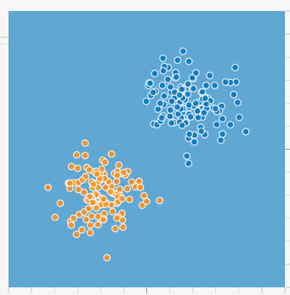
Linear Classification

Slide 6
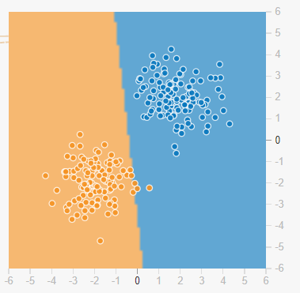
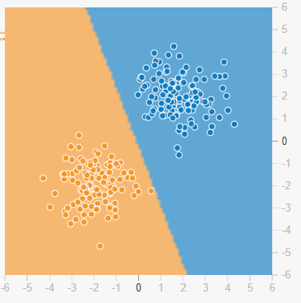
y = x*W + b

Slide 7
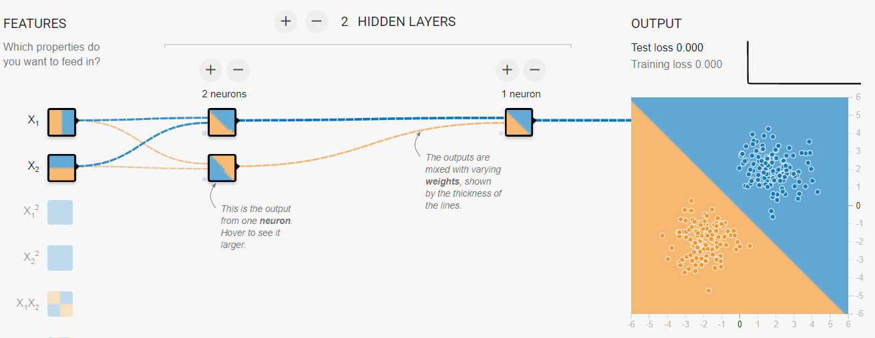

Slide 8
Neural Network Types
Neural Network Type | Usages
Multi-Layer Perceptions (MLP) | Basic type, general purpose
CNN (Convolutional Neural Networks) | Image classification
RNN (Recurrent Neural Network) | Sequences

Slide 9
Neural Network Basics
Neural network
Linear classification
Model
Layer
Training
Epoch
Loss, Accuracy
Evaluation

Slide 10
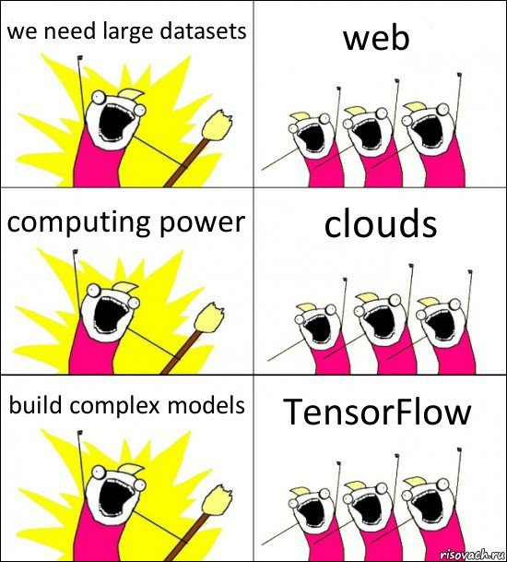

Slide 11
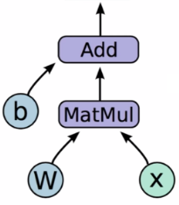
TensorFlowFlow
Model is computation graph
Vertexes are operations
Edges are tensors
Tensor
Rank
Shape
Type
Session
Variables
Queues
Optimizer
Session

Slide 12
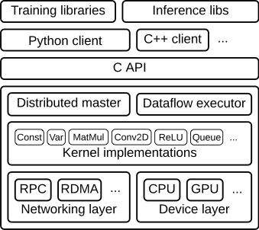
TensorFlow API
High Level API
Low Level API

Slide 13
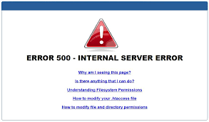
Demo - Malicious Requests Detection

Slide 14
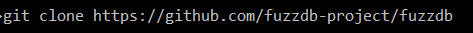
Dataset
|{"username":"john","password":"410465942"}|,0
|{"username":"' or 1=1 or ''='","password":"888691348"}|,1

Slide 15
Model
model = Sequential()
model.add(LSTM(1))
input – log record, JSON
LSTM Layer
input
from 0 to 1

Slide 16
Embedding
Dataset ~10k records
{"username":"john","password":"410465942"}
{"username":"' or 1=1 or ''='","password":"888691348"}
Index: ": 1, s: 2, a: 3, e: 4, .. Q: 93, ~: 94
Embedding Matrix W(94x1024)
Embedding [20, 2,…,14]xW
Index | Latent Factors
1 | 0.32 | 0.2 | 0.4
2 | 0.75 | 0.11 | 0.17
…
94 | 0.14 | 0.63 | 0.26

Slide 17
model = Sequential()
model.add(
Embedding(
num_words,
1,
input_length=max_log_length))
model.add(LSTM(1))
model.compile( loss='binary_crossentropy',optimizer='adam', metrics=['accuracy'])
Embedding Layer
LSTM Layer
input
from 0 to 1

Slide 18
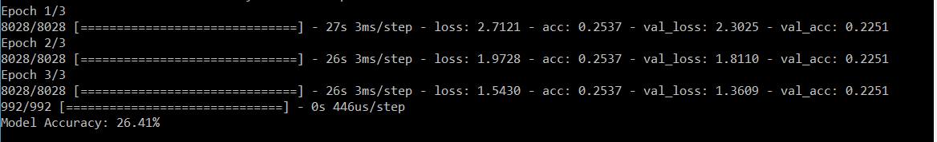
model.fit(
X_train,
Y_train,
validation_split=0.1,
batch_size=128,
epochs=3,
callbacks=[tb_callback])

Slide 19
model = Sequential()
model.add(
Embedding(
num_words,
64,
input_length=max_log_length))
model.add(LSTM(32))
model.add(Dense(1))
model.compile( loss='binary_crossentropy',optimizer='adam', metrics=['accuracy'])
Embedding Layer
LSTM Layer
Dense Layer
1
1
input
2
from 0 to 1
…
1
…
32
64

Slide 20
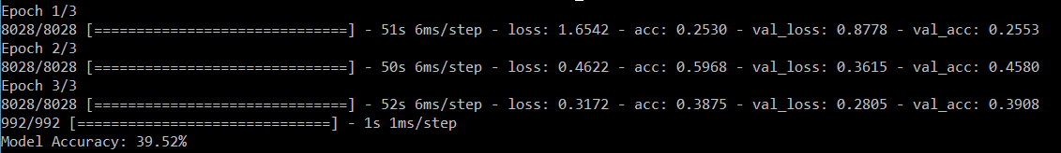
model.fit(
X_train,
Y_train,
validation_split=0.1,
batch_size=128,
epochs=3,
callbacks=[tb_callback])

Slide 21
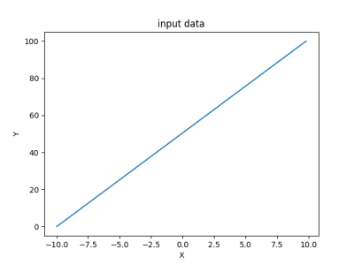

Dense Layer
Dense operation
Default activation is “linear”

Slide 22
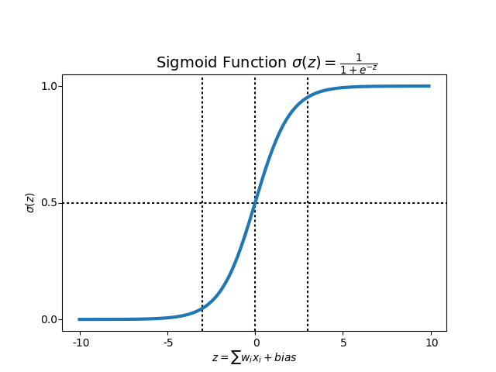
Dense Layer
Dense operation
Activation function – “sigmoid”

Slide 23
model = Sequential()
model.add(
Embedding(
num_words,
64,
input_length=max_log_length))
model.add(LSTM(32))
model.add(Dense(1, activation='sigmoid', use_bias=False))
model.compile( loss='binary_crossentropy',optimizer='adam', metrics=['accuracy'])

Slide 24
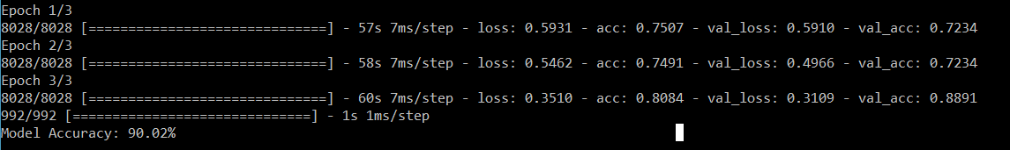
model.fit(
X_train,
Y_train,
validation_split=0.1,
batch_size=128,
epochs=3,
callbacks=[tb_callback])

Slide 25
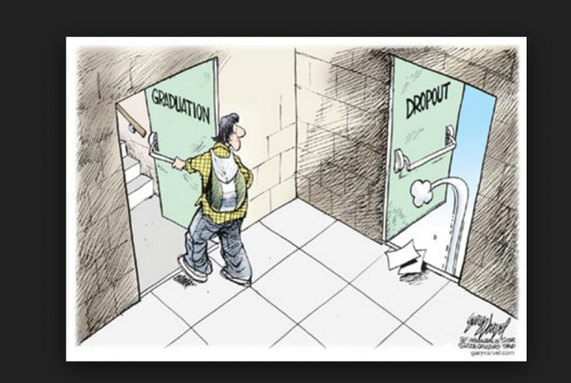
Dropout
model = Sequential()
model.add(
Embedding(
num_words,
64,
input_length=max_log_length))
model.add(LSTM(32, recurrent_dropout=0.5))
model.add(Dense(1, activation='sigmoid', use_bias=False))

Slide 26

model.fit(
X_train,
Y_train,
validation_split=0.1,
batch_size=128,
epochs=3,
callbacks=[tb_callback])

Slide 27
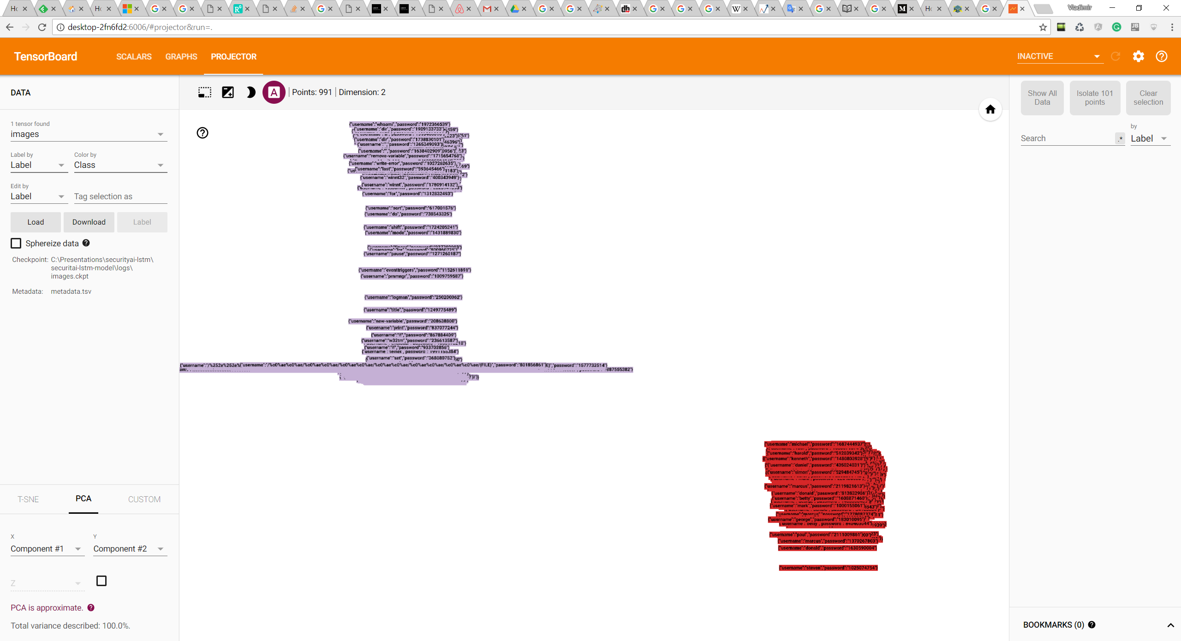

Slide 28
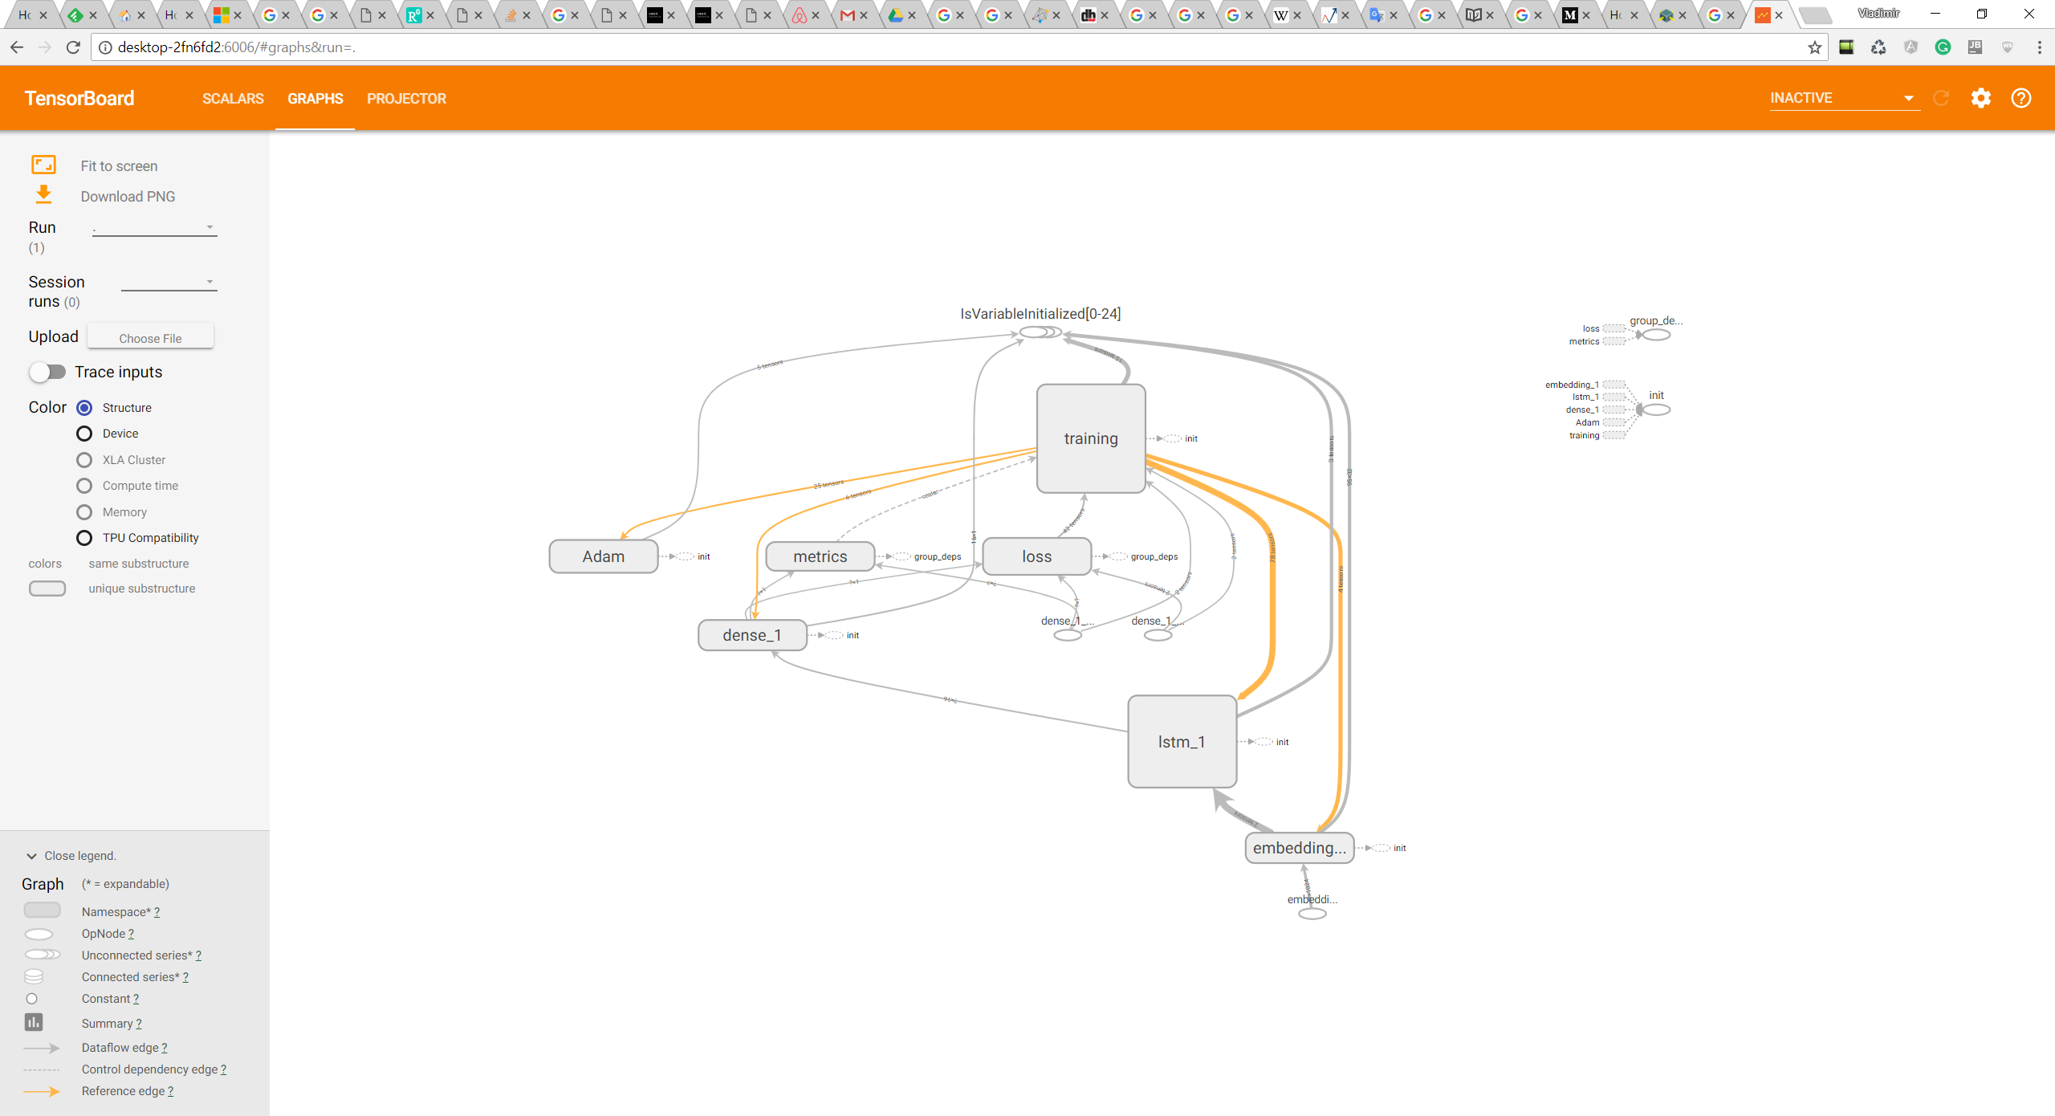

Slide 29
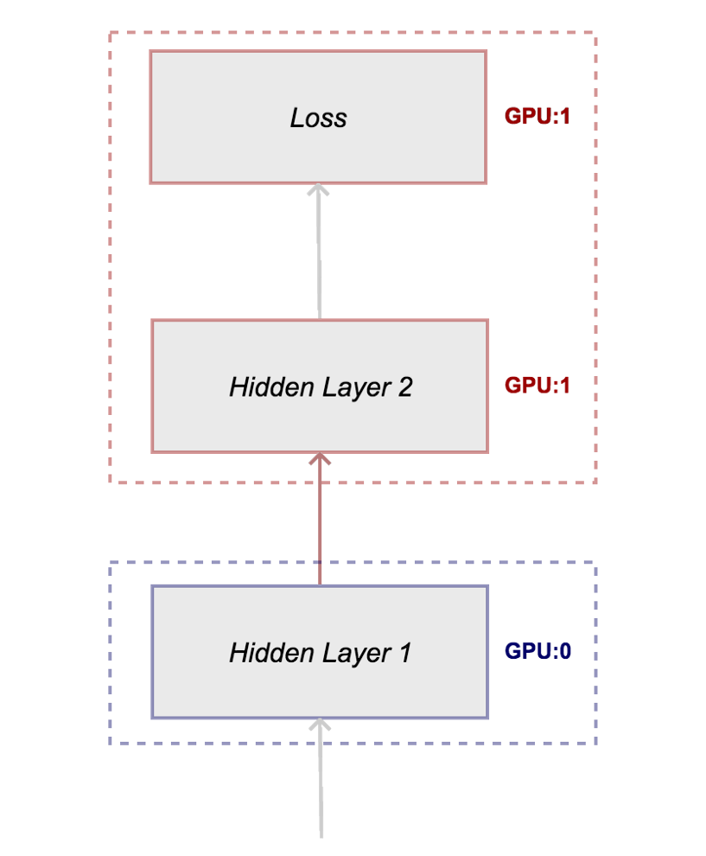
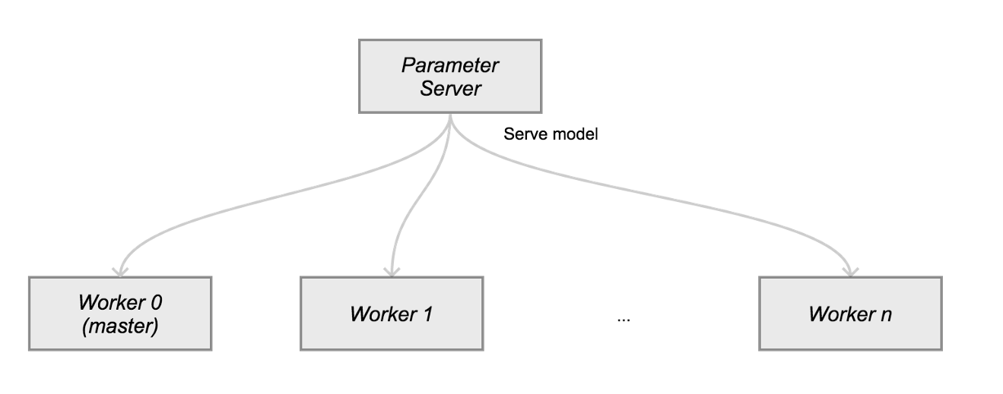
Distributed TensorFlow
Model Parallelism
Data Parallelism

Slide 30
References
Demo Source Code: https://github.com/Dorokhov/tensorflow-keras-malicious-requests-demo
TensorFlow official site: http://tensorflow.org
TensorFlow Models: https://github.com/tensorflow/models
RNN in Uber: https://eng.uber.com/neural-networks/
Embedding Explained: https://github.com/keras-team/keras/issues/3110
Text Classification: https://blog.keras.io/using-pre-trained-word-embeddings-in-a-keras-model.html
Building Own Computer Vision Cloud Service by Vladimir Dorokhov: https://www.codeproject.com/Articles/1212665/Building-Own-Computer-Vision-Cloud-Service
Videos:
Machine Learning Receipes: https://www.youtube.com/playlist?list=PLOU2XLYxmsIIuiBfYad6rFYQU_jL2ryal
TensorFlow and Deep Learning without a PhD https://www.youtube.com/watch?v=u4alGiomYP4

